Slide 1


Saving Money with
DYNAMIC PROGRAMMING

Slide 2




Problem Definition
How many unique movies can I get access from a selection of streaming services without exceeding my budget?

Slide 3

Brute Force Solution
Solved by taking every possible arrangement
Checking for the most unique movies within the budget
Returning the amount of movies

Slide 4
Time Complexity – Brute Force
Each service has an option or 1 (add to arrangement) or 0 (don’t add to arrangement) making it iterate 2^N times
In each check, we iterate through all the possible movies checking for unique movies add an iteration of M times
Time Complexity: O(M*2^N)
N -> # Services available M -> # Available movies

Slide 5
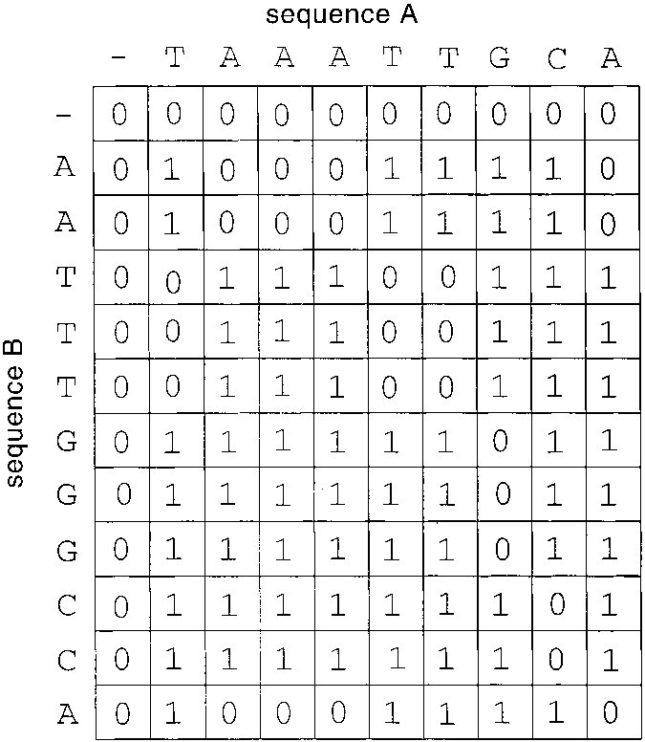
A better way?
We can solve this problem using… Dynamic Programming
To do so, we will:
Use a table to store and re-use information
Reduce the time complexity massively

Slide 6
Technique to Solving the Problem
Creating a 3d table (Budget x Services x Movies)
Iterate across the Budget and Services in order to fill the table with how many unique movies can be accessed
Each cell, iterate through Movies in linear time to calculate the amount of unique movies
Return the lowest right cell in the table

Slide 7
Pseudo Code
FOR each service I FROM 1 TO SERVICE_COUNT: FOR each budget j from 1 TO BUDGET: IF j > current_price: int unique_movies = 0 FOR each movie m FROM 1 TO MOVIE_COUNT: IF I offers movie and its not in previous I: unique_movies++ movie_table[i][j][0] = MAX( movie_table[i-1][j][0], movie_table[i-1][j-service_price][0] + unique_movies ) ELSE: movie_table[i][j][0] = movie_table[i-1][j][0] RETURN movie_table[SERVICE_COUNT][BUDGET][0]

Slide 8
Time Complexity – Dynamic Programming
Iterate throughout the budget amount (N)
Iterate throughout the service amount (K)
Iterate throughout the movie amount (M)
Time Complexity: O(MNK)

Slide 9
Comparison
Brute Force
O(M*2^N)
Dynamic Programming
O(MNK)
Brute Force is an exponential function while Dynamic Programming creates more similar to a cubic function (although not actually cubic).

Slide 10

References
The complete beginners guide to dynamic programming - Stack Overflow

